Slide 1
Client-Server Model Explained
Networking & Communication

Slide 2
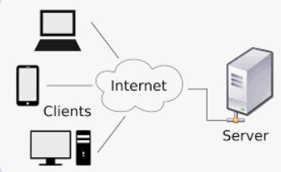
What is the Client-Server Model?
A computing model where clients request services and servers provide them.
Foundation of modern web, database, and application architectures.
Why is it important?
  Enables eﬃcient resource management.
  Used in web browsing, email, APIs, databases, and cloud services.
Real-world examples:
  Browsing a website (Browser = Client, Web Server = Server).
  Sending an email (Email App = Client, Mail Server = Server).

Slide 3
Key Components of the Client-Server Model
Client:
  The user-facing application that sends requests.
  Examples: Web browser, mobile app, API consumer.
Server:
  A system that processes requests and returns responses.
  Examples: Web server, database server, mail server.
Network:
  The medium that facilitates communication between clients and servers.
  Examples: Internet, LAN, Wi-Fi, 5G.

Slide 4
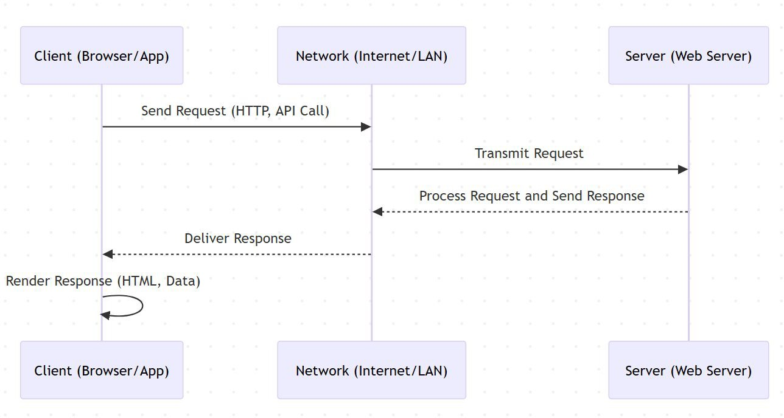
How Clients and Servers Communicate
Basic Steps:
  Client sends a request (HTTP, SQL query, etc.).
  Request is transmitted over the network.
  Server receives and processes the request.
  Server sends a response.
  Client receives and processes the response.
Types of Communication:
  Request/Response Model (e.g., HTTP, REST APIs)
  Persistent Connections (e.g., WebSockets, FTP sessions)

Slide 5
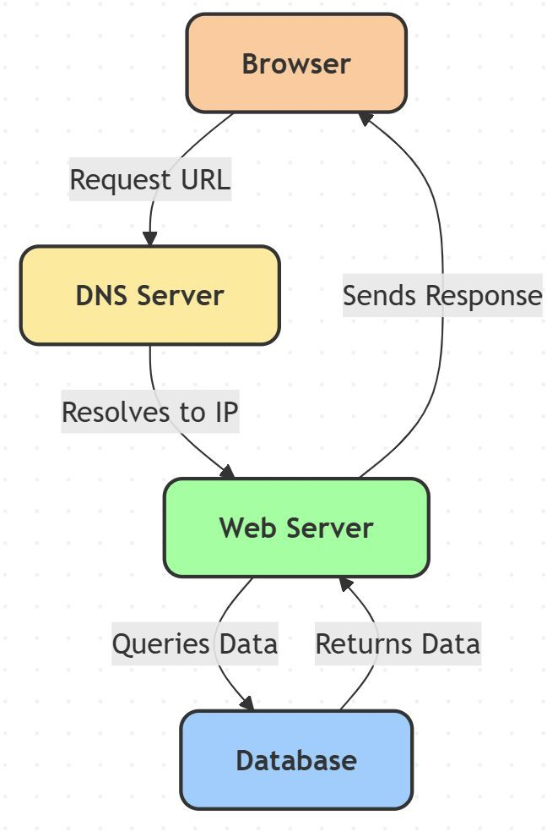
The Request-Response Cycle (HTTP Example)
Browser requests https://example.com.
DNS resolves domain to IP address.
Browser sends an HTTP GET request to the web server.
Web server processes request, fetches HTML, queries the database if needed.
Server sends an HTTP response with a status code (200 OK) and the webpage content.
Browser renders the webpage.

Slide 6
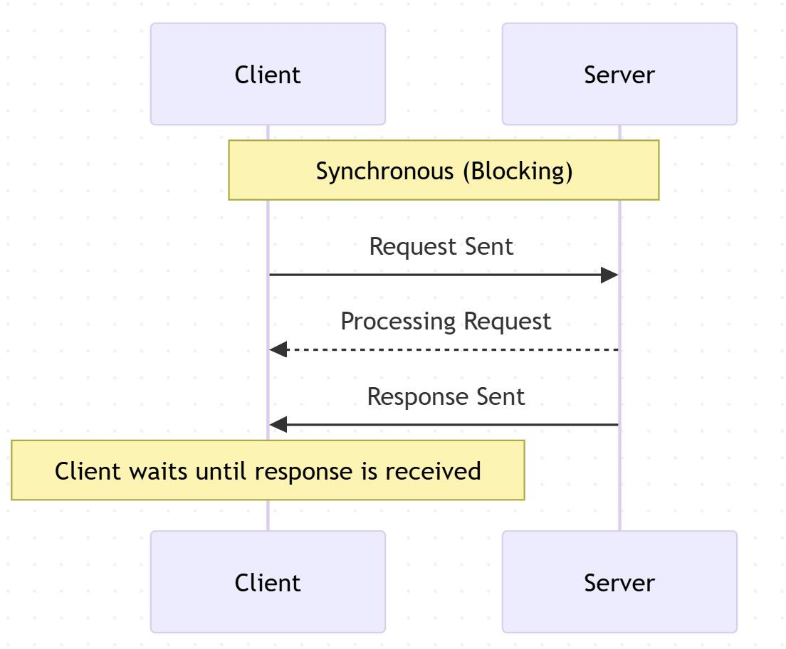
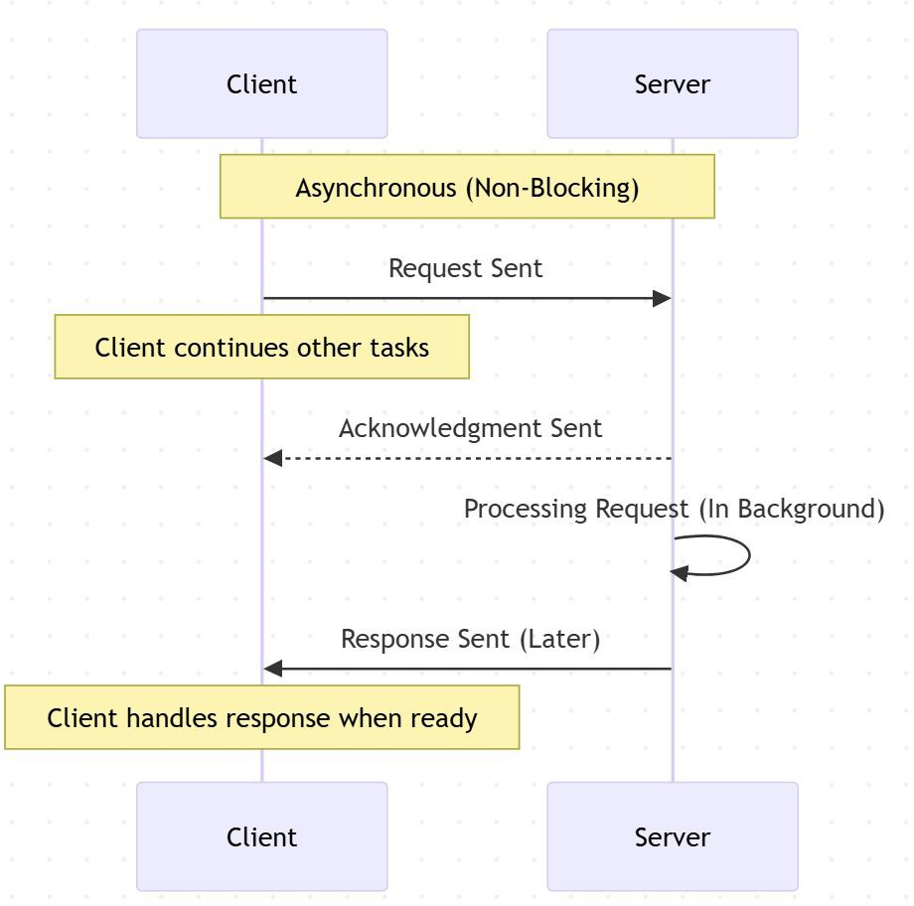
Synchronous vs Asynchronous Communication
Synchronous Communication:
  Client waits for a response before proceeding.
  Example: A user submits a form and
waits for a conﬁrmation message.
  Used in REST APIs, traditional web apps.
Asynchronous Communication:
  Client doesn’t wait for a response and can perform other tasks.
  Example: WebSockets for real-time
chat, AJAX for background requests.
  Used in messaging apps, live updates, IoT applications.

Slide 7
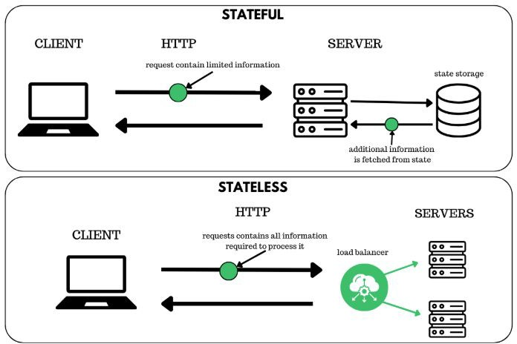
Stateless vs Stateful Servers
Stateless Servers:
  No memory of past interactions; each request is independent.
  Example: REST APIs, HTTP servers.
  Beneﬁts: Scalability, easy caching, load balancing.
Stateful Servers:
  Maintain session information across requests.
  Example: WebSockets, multiplayer games, banking applications.
  Beneﬁts: Personalization, seamless user experiences.

Slide 8
Real-World Examples
Web Applications:
  Browsing a website (Client = Browser, Server = Web Server).
APIs & Microservices:
  Mobile apps calling backend APIs (REST, GraphQL).
Databases:
  A client querying a database (SQL Client → Database Server).
Messaging Systems:
  WhatsApp, Slack using WebSockets for real-time communication.

Slide 9
Interview Questions on the Client-Server Model
Fundamental Questions:
  What is the client-server model, and how does it work?
  How does a client communicate with a server?
  What are some real-world examples of the client-server model?
  What is the diﬀerence between a client and a server?
Request-Response Cycle Questions:
  Explain the HTTP request-response cycle with an example.
  What are the key diﬀerences between synchronous and asynchronous communication?
  How does a browser load a webpage? Walk me through the steps.
Architecture and Design Questions:
  What is the diﬀerence between stateless and stateful servers?
  How does caching improve performance in a client-server model?
  How do load balancers work in a client-server architecture?
Advanced Questions:
  What are some security challenges in the client-server model?
  How does WebSockets diﬀer from traditional request-response communication?
  What are some limitations of the client-server model? How can they be addressed?
  How would you design a scalable client-server system for a high-traﬃc application?

Slide 10
Wrap up and what’s next….
Key Takeaways:
  The client-server model underpins most modern computing.
  Diﬀerent communication patterns (sync vs async, stateless vs stateful) optimize performance for diﬀerent use cases.
  Understanding this model helps in system design and scalability planning.
Next Steps:
  Forward Proxy vs. Reverse Proxy

